Slide 1

ComFix’24
SAILINK
Bridging hearts acress the waves
M.P. Wickramarathne
S.D.T. Perera
N.P.S.S. Rupasinghe

Slide 2


Slide 3
අඹුදරු රැක ගන්න අපට
මාලු ලබා දෙන්න දෙවියනේ!!!

Slide 4
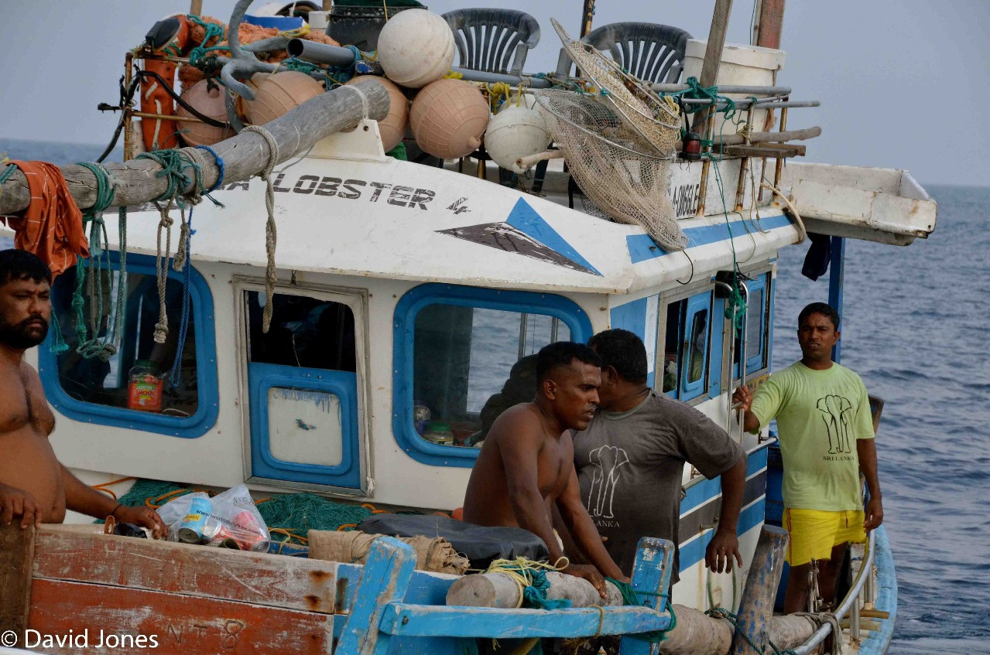


Slide 5






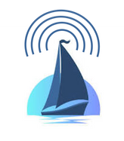
Is it really imposible ?

Slide 6

How it’s done Now.

Slide 7
SAILINK
Bridging hearts acress the waves

Slide 8
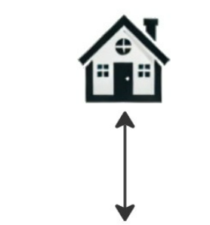
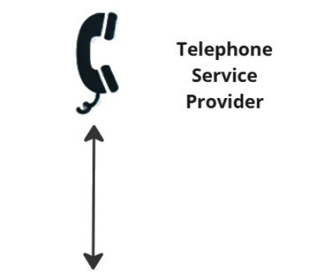
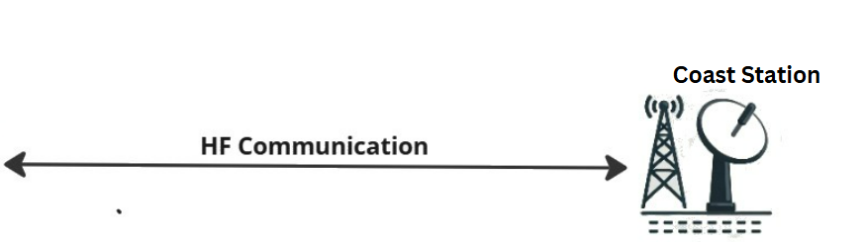

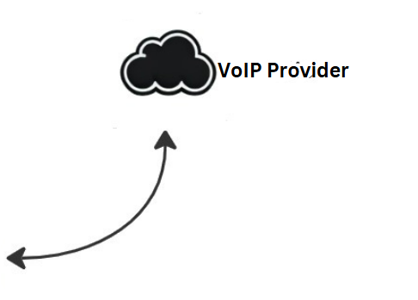
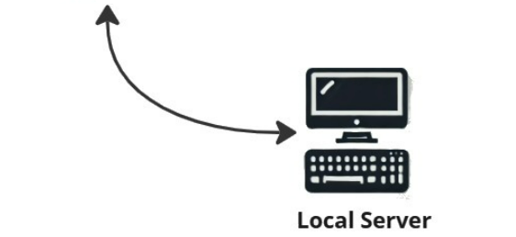
Current
Implementation
SAILINK
V1

Slide 9
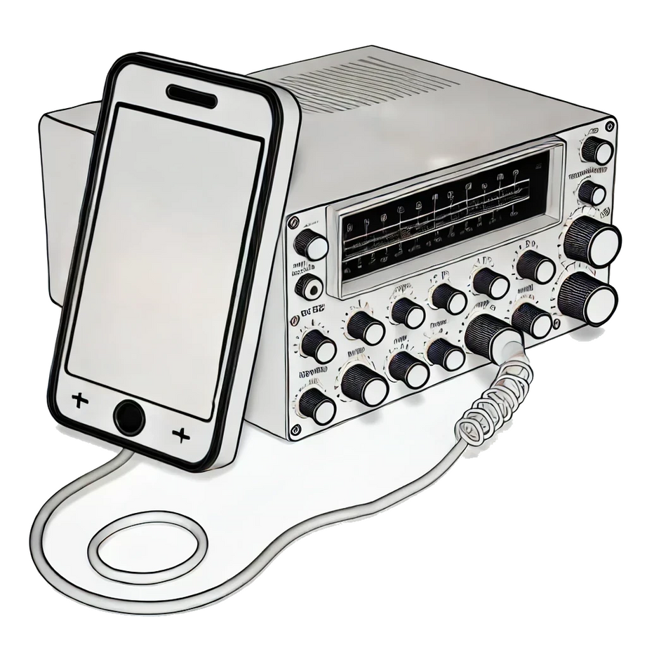

How
Hello Sweetie,
I see the Whales

Slide 10


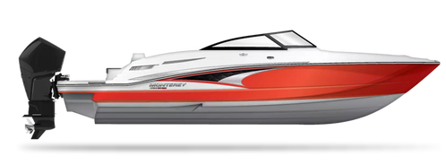
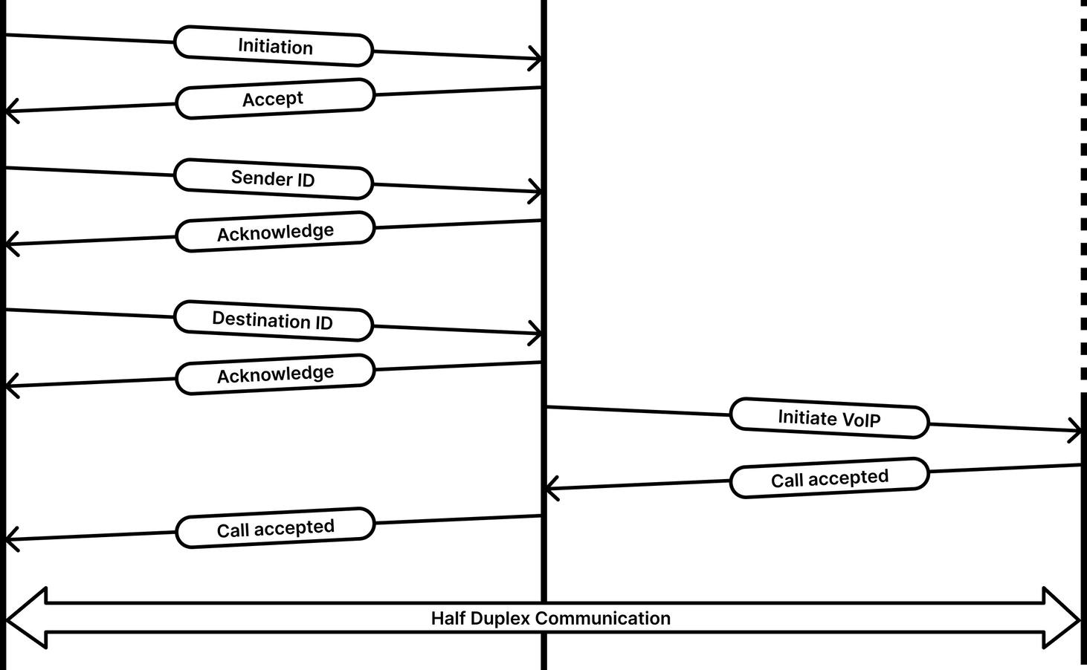
Call Initiation

Slide 11
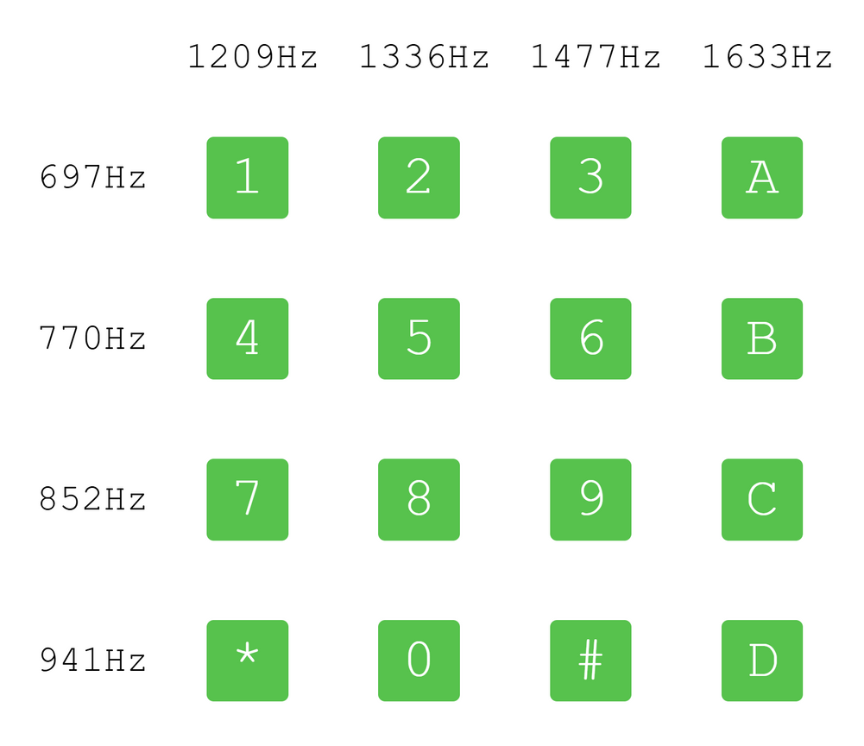
Dual-Tone Multi-Frequency
Built on top of existing standards
Minimal interference
Exclusion of Vocal Range
Ease of generation and detection
Avoidance of Harmonics

Slide 12
Features and Characteristics
of SAILINK Protocol
Acknowledgement
Checksum Verification
Retransmission
Arbitration
Timeouts

Slide 13
feasibility
Compatible with existing infrastructure
Simple
Robust

Slide 14
Challenges
Half-duplex communication
Low-quality voice
Voice will be broadcast
Manual tuning of the HF set
Security concerns

Slide 15
What Next?
Digital Communication
Encryption
Noise Reduction
Channel Hopping
Auto-tuning HF Sets

Slide 16

Thank You !

Slide 17
SAILINK
Bridging hearts acress the waves

